Slide 1

Time-Complexity of Key-Insertion in Python Dicts
Rob Orsini
https://code.tupleshop.com

Slide 2
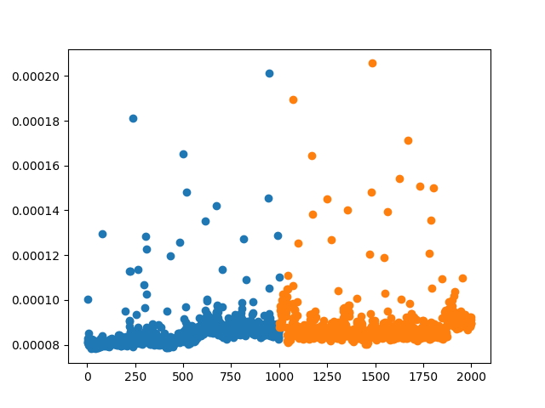
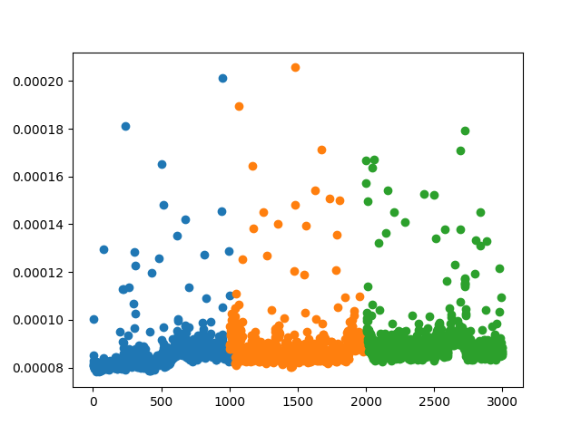
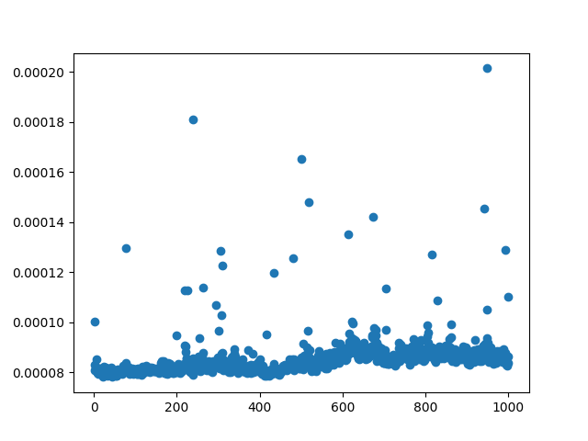
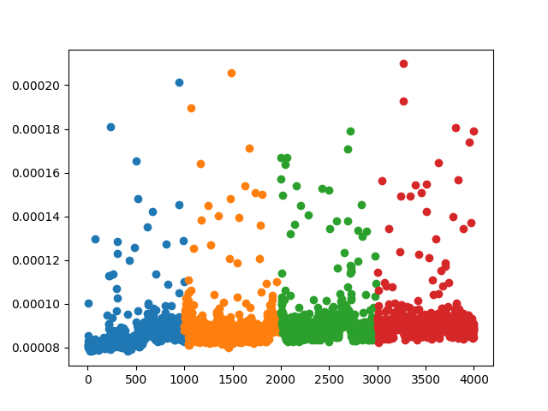
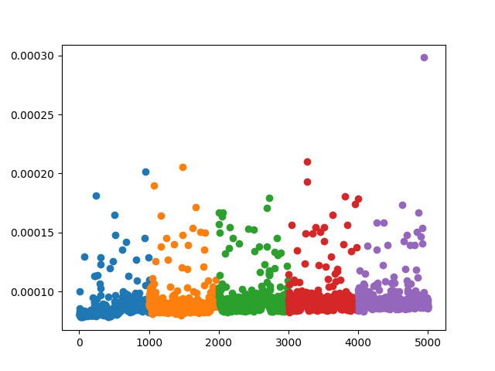
(0, 1000)
(1000, 2000)
(2000, 3000)
(3000, 4000)
(4000, 5000)
Initial bucket sizes showed O(1)
Too similar

Slide 3
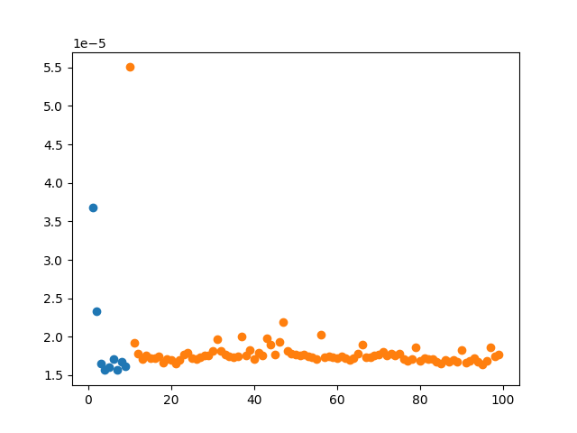
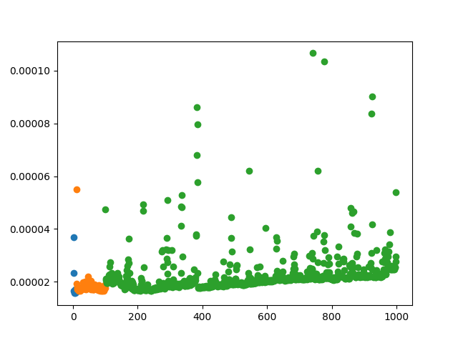
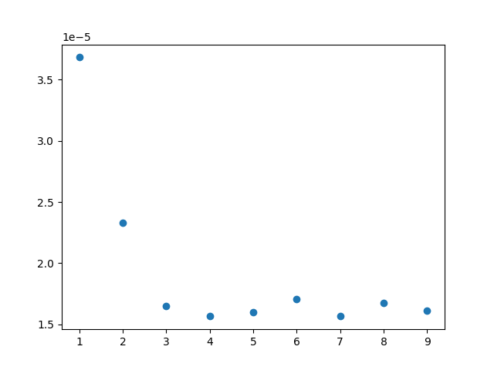
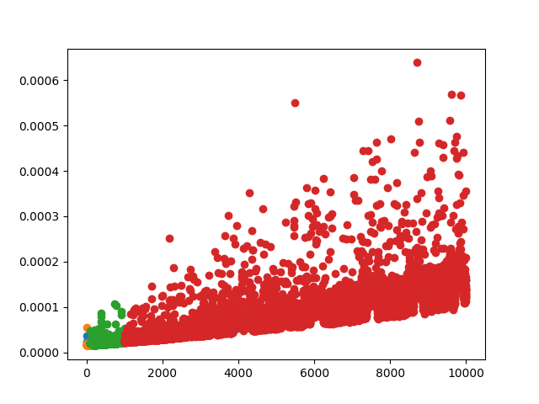
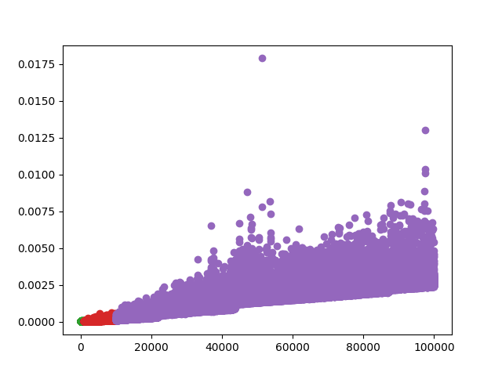
Exponentially larger buckets indicate O(N)
(1, 10)
(10, 100)
(100, 1000)
(1000, 10000)
(10000, 100000)

Slide 4
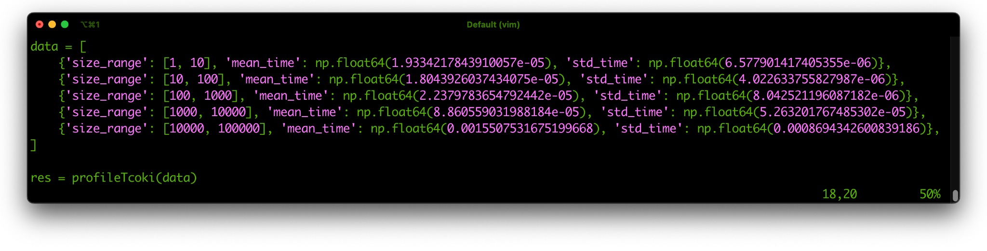
Data summary from five bucket runs

Slide 5
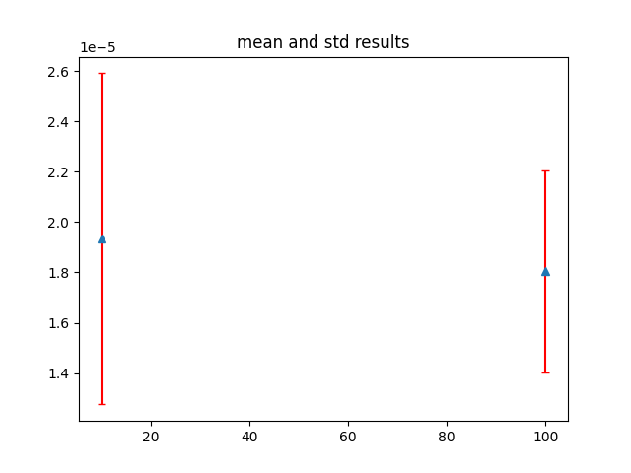
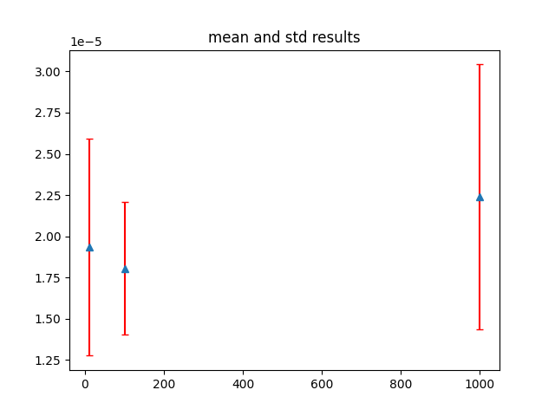
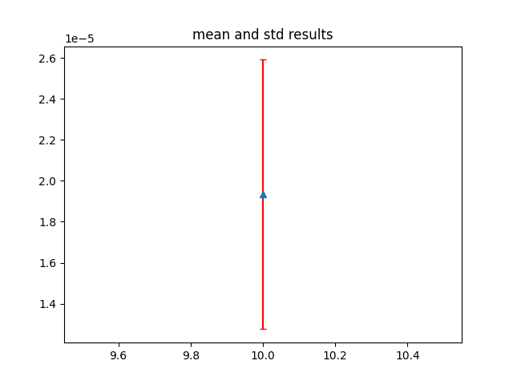
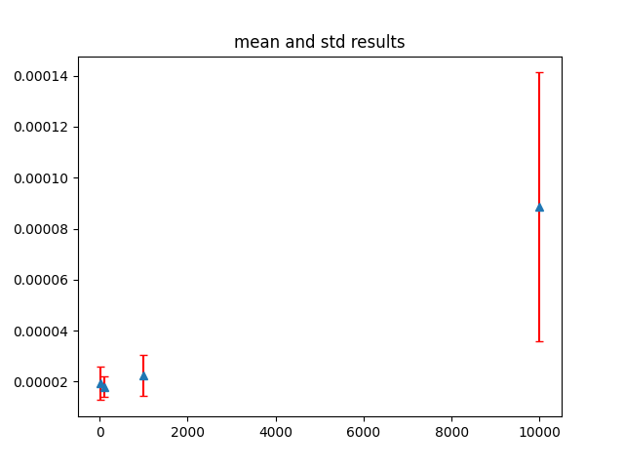
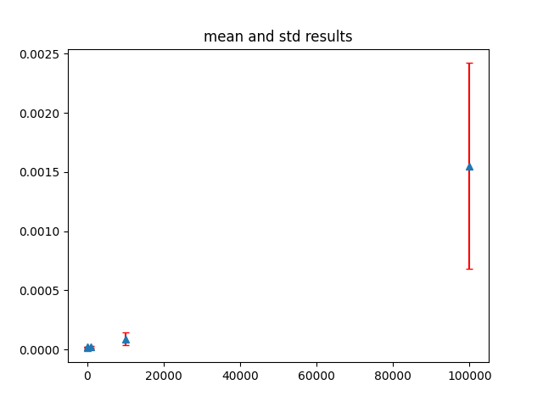
Plots of mean and standard deviation per run

Slide 6
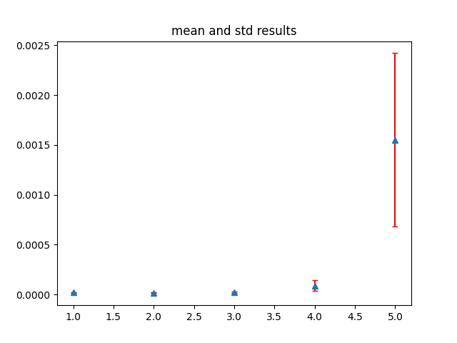
Mean and standard deviation summarized
(1, 10)
(10, 100)
(100, 1000)
(1000, 10000)
(10000, 100000)

Slide 7
O(1)
The time-complexity of key-insertion in Python dictionaries is constant complexity.
However, as the dictionary size gets very large the time-complexity approaches linear complexity.
O(N)

